Slide 1
Interested Information Extraction from Document Images
ACCENTURE NEW IT
Xiaohui Zhao Ph.D.

Slide 2
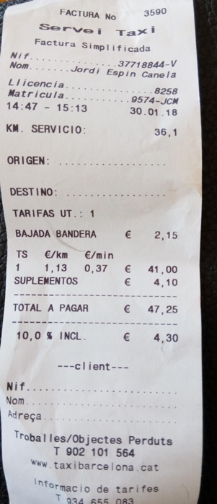
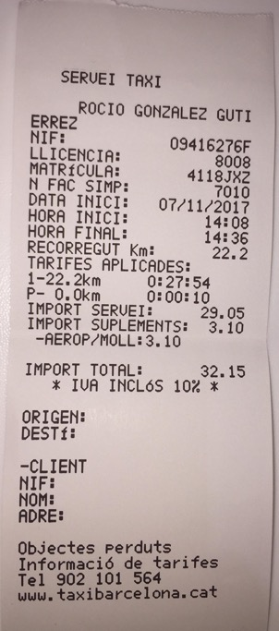
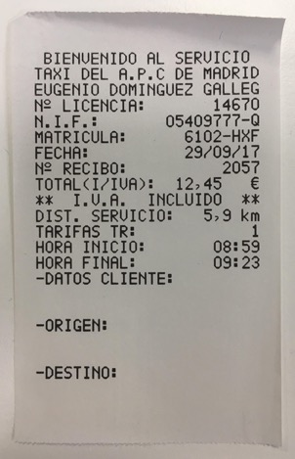
0. Scope
Invoices / receipts present with various styles of layouts even for the same type of invoices, e.g., below taxi invoices demonstrate with various layouts and keywords. Automatically extracting interested words / information from the scanned documents is of great interest to the markets.
The interested <TOTAL> information of different layouts of invoices appear in various positions with different keyword clues.

Slide 3
 | BIEVENIDO | AL | SERVICIO
TAXI | DEL | A.P.C | DE | MADRID
EUGENIO |  | DOMINGUEZ |  | GALLEG
N° | LICENCIA: |  |  | 14670
...
TOTAL | (I/IVA): | 12,45 |  | €
** | I.V.A. |  | INCLUTIDO | **
DIST. | SERVICIO: |  | 5,9 | km
TARIFAS | TR: |  |  | 1
HORA | INICIO: |  |  | 08:59
HORA | FINAL: |  |  | 09:23
-DATOS | CLIENTE:
-ORIGEN:
-DESTINO:
 | BIEVENIDO | AL | SERVICIO
TAXI | DEL | A.P.C | DE | MADRID
EUGENIO |  | DOMINGUEZ |  | GALLEG
N° | LICENCIA: |  |  | 14670
...
TOTAL | (I/IVA): | 12,45 |  | €
** | I.V.A. |  | INCLUTIDO | **
DIST. | SERVICIO: |  | 5,9 | km
TARIFAS | TR: |  |  | 1
HORA | INICIO: |  |  | 08:59
HORA | FINAL: |  |  | 09:23
-DATOS | CLIENTE:
-ORIGEN:
-DESTINO:
(b)
CUTIE
(c)
(a)

Slide 4
 | BIEVENIDO | AL | SERVICIO
TAXI | DEL | A.P.C | DE | MADRID
EUGENIO |  | DOMINGUEZ |  | GALLEG
N° | LICENCIA: |  |  | 14670
...
TOTAL | (I/IVA): | 12,45 |  | €
** | I.V.A. |  | INCLUTIDO | **
DIST. | SERVICIO: |  | 5,9 | km
TARIFAS | TR: |  |  | 1
HORA | INICIO: |  |  | 08:59
HORA | FINAL: |  |  | 09:23
-DATOS | CLIENTE:
-ORIGEN:
-DESTINO:

Slide 5
0.1 Major Concerns
Invoices / receipts present with various styles of layouts even for the same type of invoices.
Various key words for the interested information, which introduces difficulties but can be solved with larger dictionary in combination with expert designed rules.
Various layouts even for the same type of invoices, which introduces even greater difficulties but can be solved with supervised learning that employs the spatial information.
Customs’ needs of new-type invoices shall be responded promptly which always takes too much time due to distinctively new layout but can be relieved by transform learning from well trained AI models and involving human in the loop.

Slide 6
0.1 Major Concerns
Invoices / receipts present with various styles of layouts even for the same type of invoices.
Various key words for the interested information, which introduces difficulties but can be solved with larger dictionary in combination with expert designed rules.
Various layouts even for the same type of invoices, which introduces even greater difficulties but can be solved with supervised learning that employs the spatial information.
Customs’ needs of new-type invoices shall be responded promptly which always takes too much time due to distinctively new layout but can be relieved by transform learning from well trained AI models and involving human in the loop.

Slide 7
1. Potential Solution
Several methods (with different performances) can used for extracting interested information from various types or layouts of receipts.
Ruled based methods for locating the interested information.
Advantages: good estimation of performance of the rule on any specific types of invoices.
Drawbacks: long-time development and slow adaption to new types of invoices, rules shall be designed for each interested information in any types of layouts of any specific invoices.
AI based supervised training models for automatically extracting the interested information.
Advantages: no additional work is needed for adapting the model to different layouts of one specific type of invoices, less costs in method implementation for new types of invoices or interested information.
Drawbacks: labeled data are needed for model training, where human labeler are needed.
UI based for reducing operator’s labors for finding/processing the interested information.
Advantages: operator friendly.
Drawbacks: highly experienced UI/UX developers shall be involved to analysis and design the UI that has the truly user friendly operating logic.
Assembling the rule / AI / UI based methods can achieve potentially better result.

Slide 8



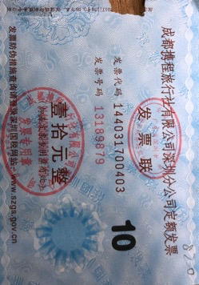
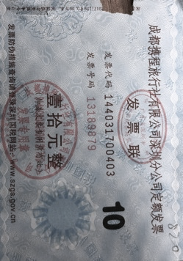






2. Danny Closed Loop
enjoy
the
loop
Processing
Labeling
Human operator
Data base
Final Results
Cloud storage
×1000 invoices
AI models
Rule algorithms

Slide 9


2. Danny Closed Loop
enjoy
the
loop
Processing
Labeling
Human in the loop
Data in the loop
Final Results
Cloud in the loop
×1000 invoices
AI in the loop
Rules in the loop

Slide 10
Appendix: Different Words in Diff Layouts
Examples of the same type of invoices in different layouts
The interested <TOTAL> information of different layouts of invoices appear in various positions with different keyword clues.

Slide 11
Appendix: Diff Invoices In Diff Layouts
Examples of same types of invoices in different layouts (rules face difficulty)

Slide 12
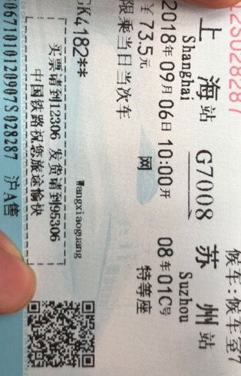
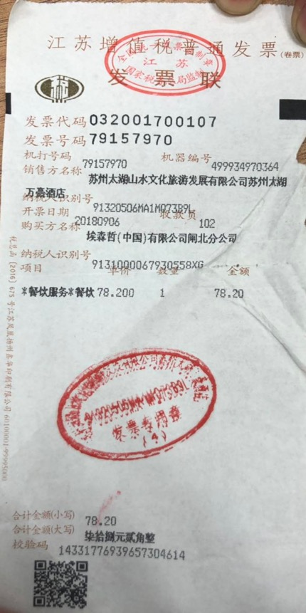
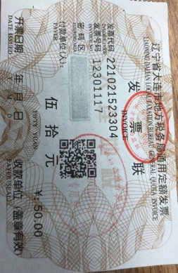
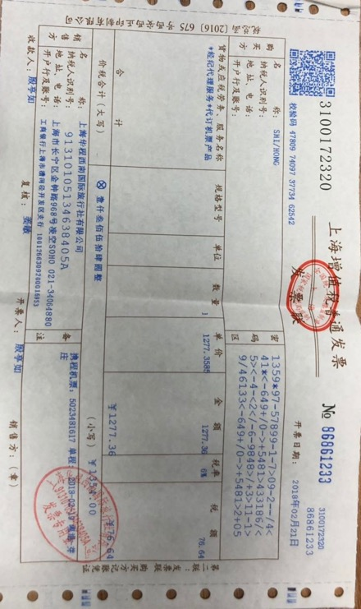
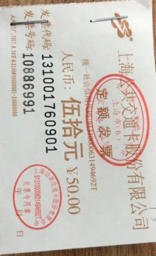
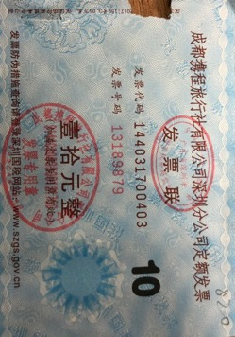
Appendix: Diff Invoices In Diff Layouts
Examples of different types of invoices in different layouts
The interested <金额> information of different types of invoices appear in various positions with different keyword clues.

Slide 13
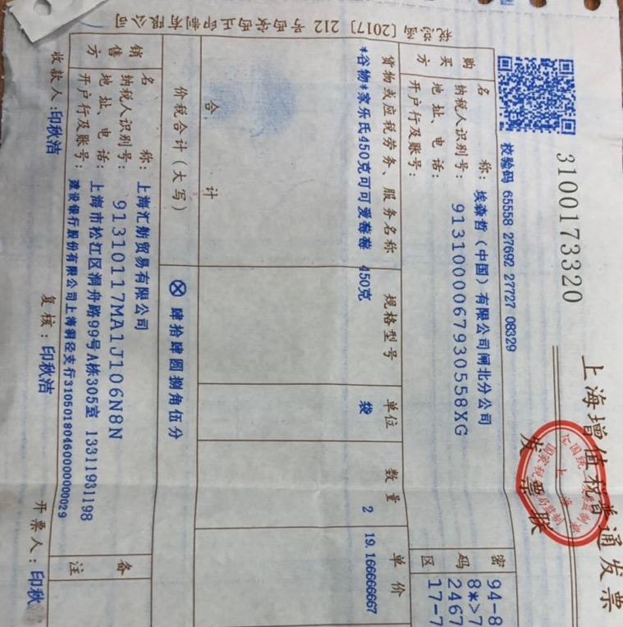
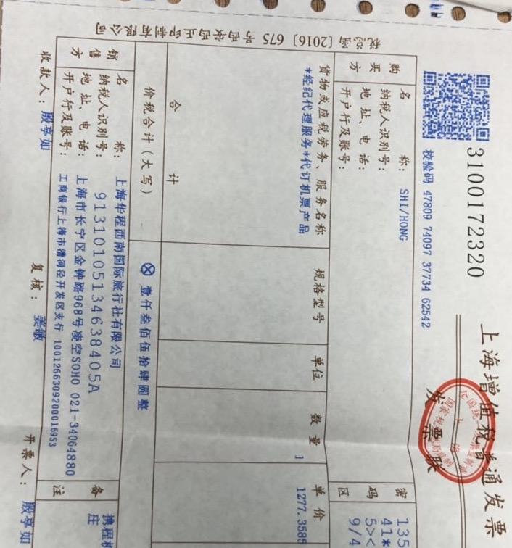
Appendix: Diff Invoices In Diff Layouts
Examples of same types of invoices in the same layout

Slide 14
Appendix: Diff Invoices In Diff Layouts
Examples of same types of invoices in different layout

Slide 15
Appendix: Diff Invoices In Diff Layouts
Examples of same types of invoices in the different layout

Slide 16
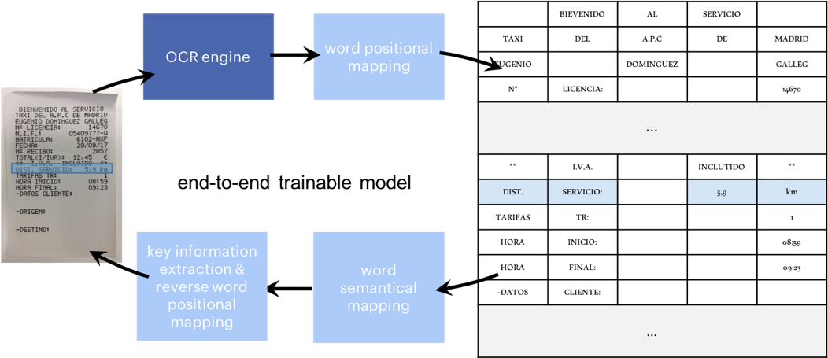
The Breakthrough in CUTIE
Tackling The Real-World Problem (Convolutional Universal Text Information Extractor)
Innovation in Training Method (proposed by experienced researcher)
Occam’s Razor (the SOTA solution for the real-world problem)
Interdisciplinary (the most used innovation method in the scientific community)
Original Code for Model Implementation (Accenture owned)

Slide 17
The Breakthrough in CUTIE
Tackling The Real-World Problem (Convolutional Universal Text Information Extractor)
Innovation in Training Method (proposed by experienced researcher)
Occam’s Razor (the SOTA solution for the real-world problem)
Interdisciplinary (the most used innovation method in the scientific community)
Original Code for Model Implementation (Accenture owned)
 | hotel | meals | taxi
Joint SLU + 8 rules + preprocessing | 60% | 64% | 82%
CUTIE (not optimized) | 70% | 74% | 87%
2×10w
1×2w

Slide 18
The Breakthrough in CUTIE
Tackling The Real-World Problem (Convolutional Universal Text Information Extractor)
Innovation in Training Method (proposed by experienced researcher)
Occam’s Razor (the SOTA solution for the real-world problem)
Interdisciplinary (the most used innovation method in the scientific community)
Original Code for Model Implementation (Accenture owned)
 | hotel | meals | taxi
Joint SLU + 8 rules + preprocessing | 60% | 64% | 82%
CUTIE (not optimized) | 70% / 90% | 74% / 88% | 87% / 95%
2×10w
1×2w

Slide 19
The Breakthrough in CUTIE
Tackling The Real-World Problem (Convolutional Universal Text Information Extractor)
Innovation in Training Method (proposed by experienced researcher)
Occam’s Razor (the SOTA solution for the real-world problem)
Interdisciplinary (the most used innovation method in the scientific community)
Original Code for Model Implementation (Accenture owned)
 | hotel | meals | taxi
Joint SLU + 8 rules + preprocessing | 60% | 64% | 82%
CUTIE (not optimized) | 70% / 90% | 74% / 88% | 87% / 95%
CUTIE (optimized) | 90+% / 70+% | 88+%/74+% | 95+% / 87+%
CUTIE (optimized) + pre/post processing + NER | perfected result through collaboration
2×10w
1×2w

Slide 20
The Breakthrough in CUTIE
Tackling The Real-World Problem (Convolutional Universal Text Information Extractor)
Innovation in Training Method (proposed by experienced researcher)
Occam’s Razor (the SOTA solution for the real-world problem)
Interdisciplinary (the most used innovation method in the scientific community)
Original Code for Model Implementation (Accenture owned)
 | hotel | meals | taxi
Joint SLU + 8 rules + preprocessing | 60% | 64% | 82%
CUTIE (not optimized) | 70% | 74% | 87%
BERT | 79.42% | 80.31% | 87.02%
CUTIE (optimized) | 90+% / 70+% | 88+%/74+% | 95+% / 87+%
CUTIE (optimized) + pre/post processing + NER | perfected result through collaboration

Slide 21
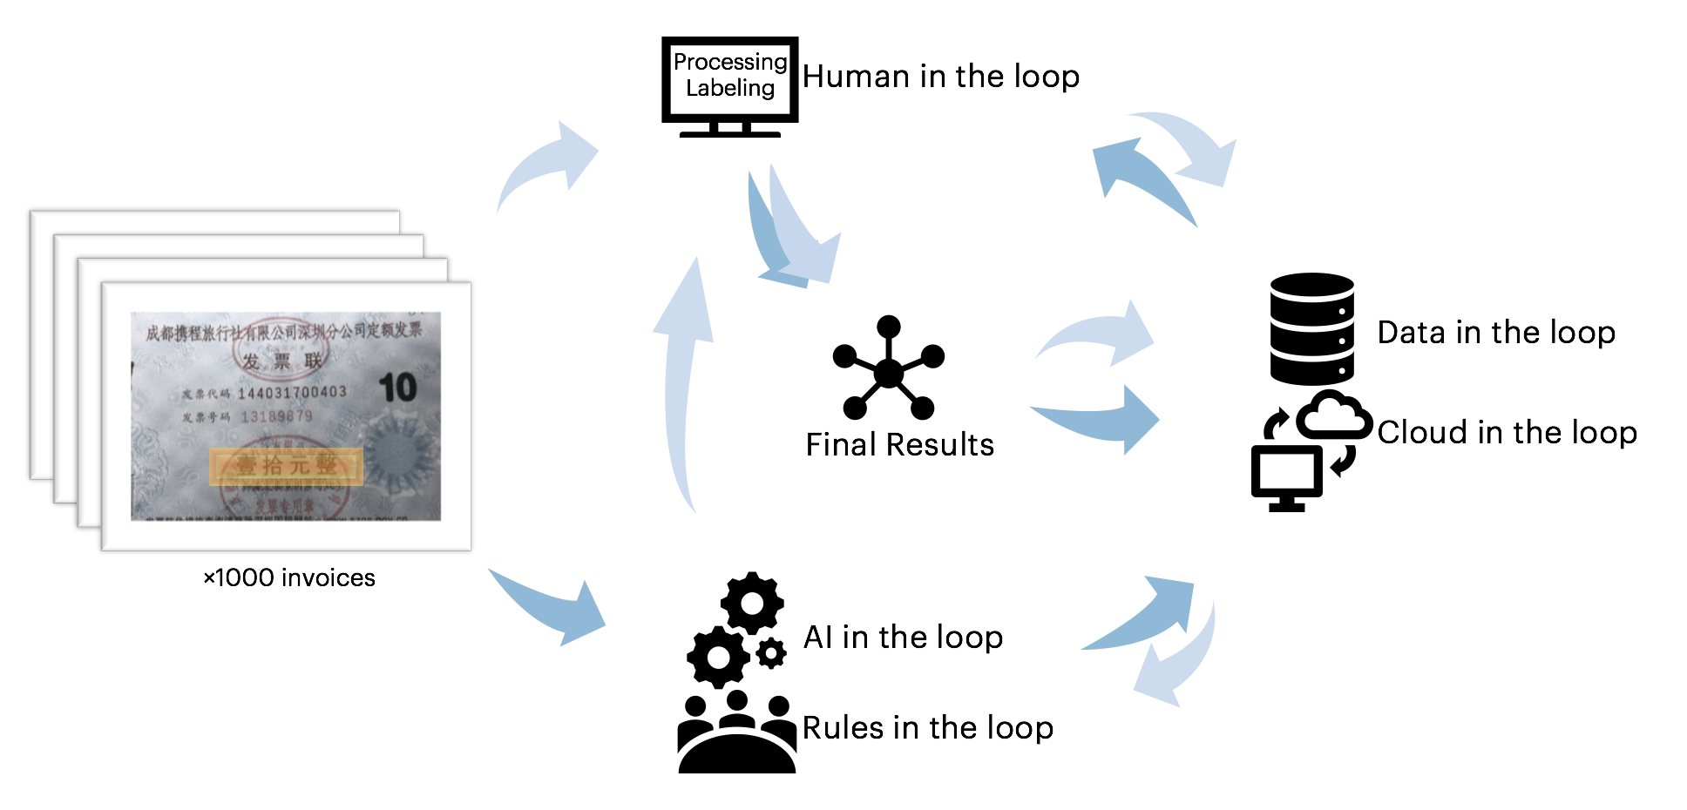
The Breakthrough in CUTIE
Tackling The Real-World Problem (Convolutional Universal Text Information Extractor)
Innovation in Training Method (proposed by experienced researcher)
Occam’s Razor (the SOTA solution for the real-world problem)
Interdisciplinary (the most used innovation method in the scientific community)
Original Code for Model Implementation (Accenture owned)

Slide 22
The Breakthrough in CUTIE (Optimized)
Tackling The Real-World Problem (Convolutional Universal Text Information Extractor)
3 months
3,431 lines of code
100+ experiments
3,000+ GPU hours (≈ $2,700+ 0.9$/h)
State of The Art performance without requirement of any pretraining or post processing
Using only 10% parameters of Google’s BERT model
Outperforms Google’s BERT model by at most 8.2%

Slide 23
The Breakthrough in CUTIE (Optimized)
Tackling The Real-World Problem (Convolutional Universal Text Information Extractor)
Innovation in Training Method (proposed by experienced researcher)
Occam’s Razor (the SOTA solution for the real-world problem)
Interdisciplinary (the most used innovation method in the scientific community)
Original Code for Model Implementation (Accenture owned)
 | meals | taxi | hotel | #Params
Joint SLU + 8 rules + preprocessing | 64% | 82% | 60% | -
CUTIE (not optimized) | 74% | 87% | 70% | 28M
BERT (pretrained) | 80.3% | 87.0% | 79.4% | 110M
CUTIE (optimized) | 84.3% / 92.4% | 95.2% / 97.6% | 70.8% / 89.4% | 14M
CUTIE (optimized) + pre/post processing + NER | perfected result through collaboration
DTU
Accenture
New IT
Google
Accenture
New IT

Slide 24
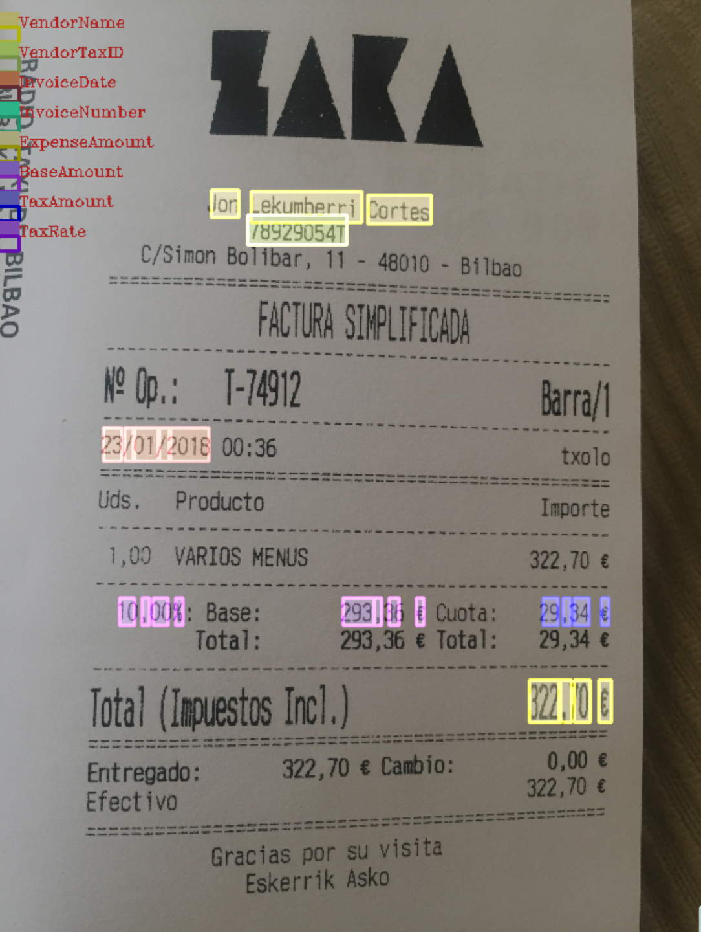
Results Visualization

Slide 25
Next steps to Universal Receipt Understanding Model
Universal Text Information Extractor
State of the art performance.
Model Optimization for Better Performance with Limited Training Data
Current model can achieve good result with limited training data.
Transfer Learning
Not feasible for current structure due to the entangling semantic and spatial feature processer.
Neural Architecture Search to Identify Best Model Structure
To-be explored.
Universal Layout Extractor
To-be explored.

Slide 26
Universal Doc Understanding Model
Define Problem
Extract information in Key-Value pairs.
Extract information in hierarchical Key-Value pairs with learning based method in quick response fashion for various styles of documents in different layouts.

Slide 27
Universal Doc Understanding Model
Define Problem
Extract information in Key-Value pairs.
Extract information in hierarchical Key-Value pairs with learning based method in quick response fashion for various styles of documents in different layouts.
Divide Problem into Sub Problems
Extract hierarchical Key-Value pairs, note certain information present in Value only fashion
Value only information
Key-Value pair
Hierarchical Key-Value pair

Slide 28
Universal Doc Understanding Model
Define Problem
Extract information in Key-Value pairs.
Extract information in hierarchical Key-Value pairs with learning based method in quick response fashion for various styles of documents in different layouts.
Divide Problem into Sub Problems
Extract hierarchical Key-Value pairs, note certain information present in Value only fashion
Value only information
Key-Value pair
Hierarchical Key-Value pair
Conquer Sub-Problems
Discover available features
text semantical meaning
text spatial information
image textual feature
document layouts, e.g., table region

Slide 29
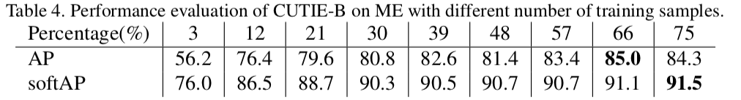
Q&A
Is it possible to employ transfer learning to draw benefits from trained documents.
No, but CUTIE is able to achieve good performance with limited training data due to its efficient structure in employing both the semantic and spatial features.. The CUTIE model learn to train the semantic feature and the spatial feature with the entire framework, where transfer learning leads to no better performance than training from scratch.
How many labelled sampled needed to achieve minimum viable model.
95.8% of CUTIE’s maximum performance can be achieved with 200~300 training samples.
How to understand any seen documents using only one single AI model.
Propose to understand documents in terms of both key information and tables by employing either semantic, spatial, or image-level texture features for conducting multi-class training.

Slide 30
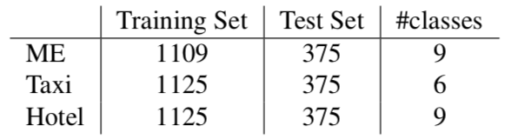
Performance Evaluation
Training Dataset
4,484 annotated scanned Spanish receipt documents with 9 different classes: ’DontCare’, ’VendorName’, ’VendorTaxID’, ’InvoiceDate’, ’InvoiceNumber’, ’ExpenseAmount’, ’BaseAmount’, ’TaxAmount’, and ’TaxRate’. Samples are evenly distributed in training and test set.
Evaluation Results (AP/softAP)
AP: one class is determined as correct only when every single token in the class is correct.
softAP: one class is determined as correct as if positive ground truths are correctly predicted even if some false positives are included in the final prediction.
 | Taxi | Meals Ent | Hotel | Table | Column | #Params | Time Cost (CPU) | Time Cost (GPU)
CUTIE (trained from scratch) | 94.0% | 81.5% | 74.6% | 86.0% | 94.8% | 14M | 0.94 ~ 1.28 s/F | 0.02 ~ 0.16 s/F
BERT (transfer learned) | 88.1% | 80.1% | 71.7% |  |  | 110M

Slide 31
Performance Evaluation
Training Dataset
4,484 annotated scanned Spanish receipt documents with 9 different classes: ’DontCare’, ’VendorName’, ’VendorTaxID’, ’InvoiceDate’, ’InvoiceNumber’, ’ExpenseAmount’, ’BaseAmount’, ’TaxAmount’, and ’TaxRate’. Samples are evenly distributed in training and test set.
Evaluation Results (AP/softAP)
AP: one class is determined as correct only when every single token in the class is correct.
softAP: one class is determined as correct as if positive ground truths are correctly predicted even if some false positives are included in the final prediction.
 | Taxi | Meals Ent | Hotel | Table | Column | #Params | Time Cost (CPU) | Time Cost (GPU)
CUTIE (trained from scratch) | 94.0% / 97.3% | 81.5% / 89.7% | 74.6% / 87.0% | 86.0% / 90.7% | 94.8% | 14M | 0.94 ~ 1.28 s/F | 0.02 ~ 0.16 s/F
BERT (transfer learned) | 88.1% | 80.1% | 71.7% |  |  | 110M

Slide 32
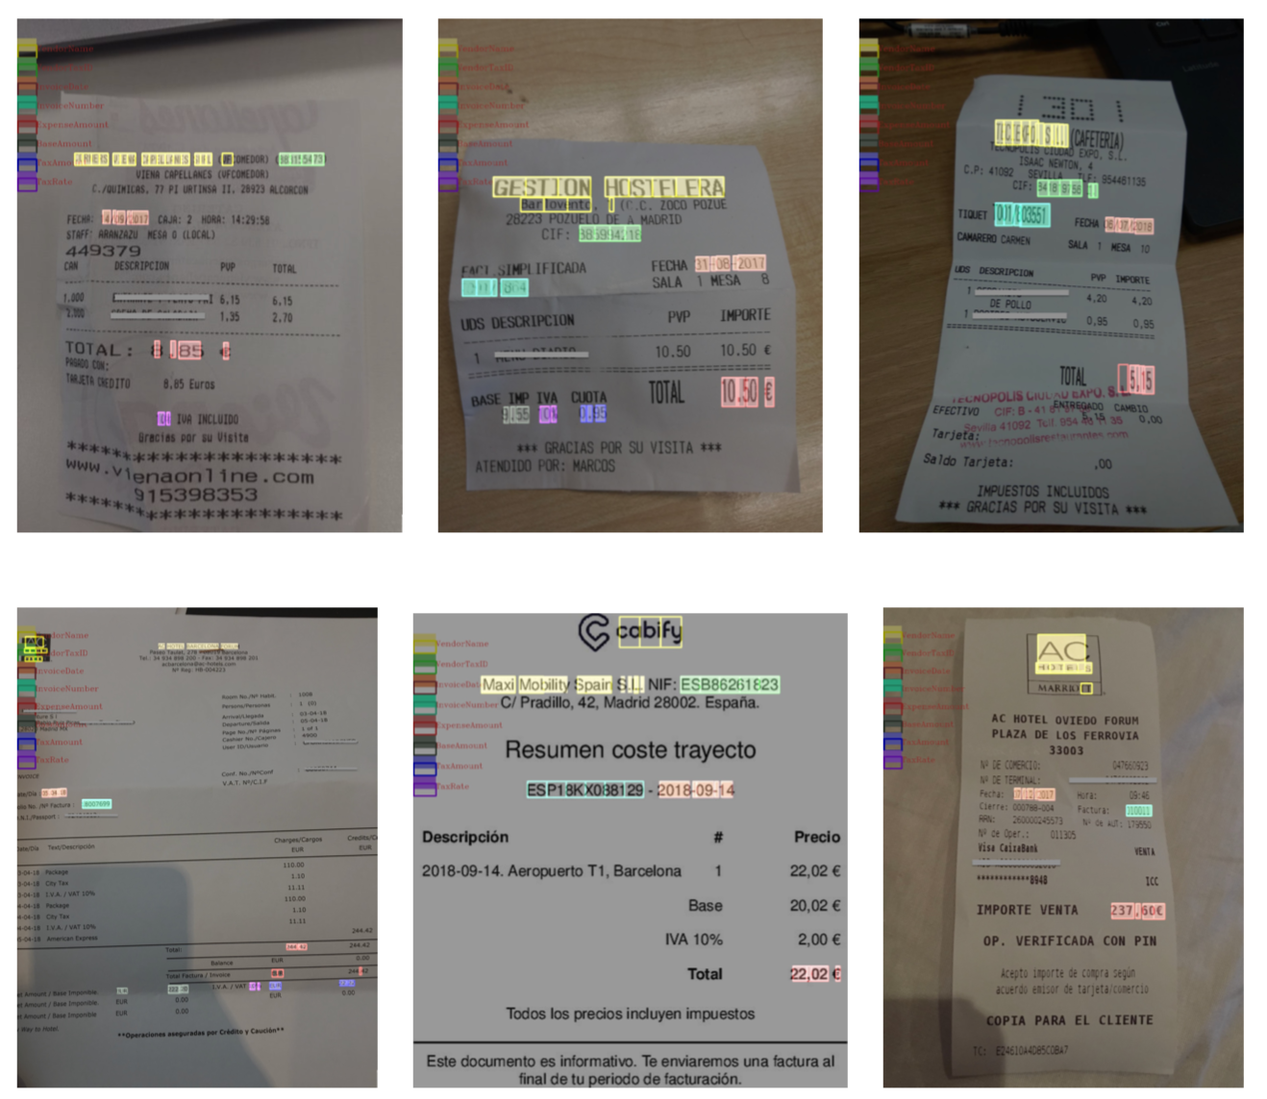
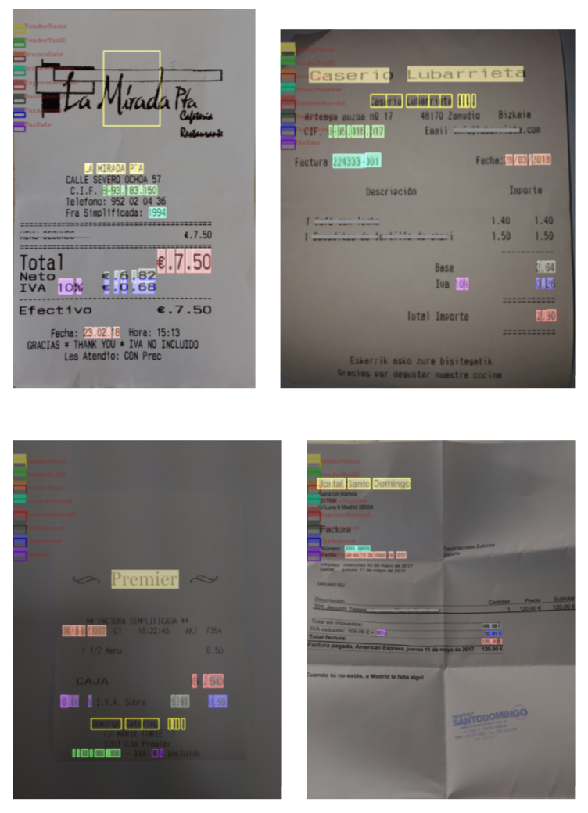
Error Cases

